Slide 1
OSS & Linux on Azure
Name
Title
Notes:
Suggested Working title: How Microsoft learned to love Java

Slide 2




We’re Reimagining Microsoft
Our Mission
Our Strategy
Build the best-in-class platforms and productivity services for the mobile-first, cloud-first world
We will empower
every person and
every organization
on the planet
to achieve more
Our Ambitions
Reinvent productivity & business processes
Build the intelligent cloud platform
Create more personal computing
Notes:
[Script]:
Every great company has an enduring mission. We’ve challenged ourselves to think about our core mission, our soul – what would be lost if we disappeared.
We will empower every person and every organization on the planet to achieve more. We have unique capabilities in harmonizing the needs of both individuals and organizations. This is in our DNA. Perhaps “on the planet” is the most important and interesting idea in that statement. We care deeply about making a difference in lives and organizations in all corners of the planet.
Our strategy is to build best-in-class platforms and productivity services for a mobile-first, cloud-first world. Our platforms will harmonize the interests of end users, developers and IT better than any competing ecosystem or platform. We will realize our mission and strategy by investing in three interconnected and bold ambitions.
Again, doing so isn’t simply good business. It’s playing a part in the most fundamental of human activities: creating tools that enable each of us to continue our journey to become something more. In summary, we want to Empower you to achieve more!

Slide 3
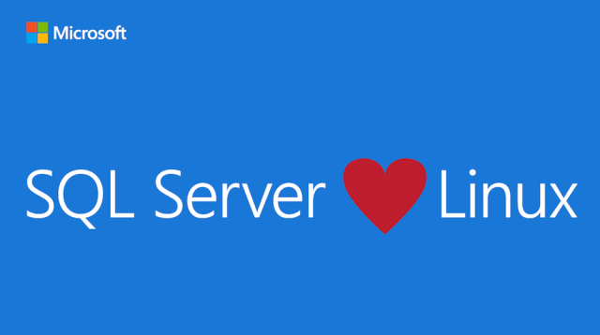

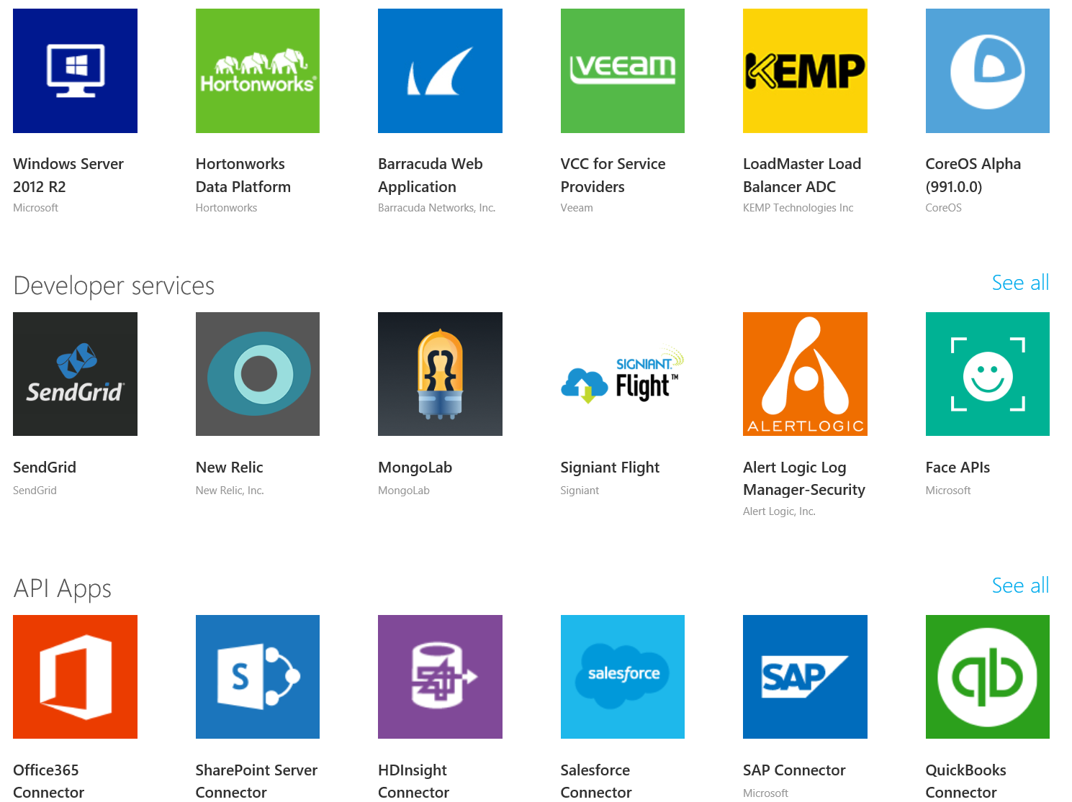
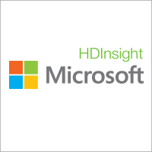

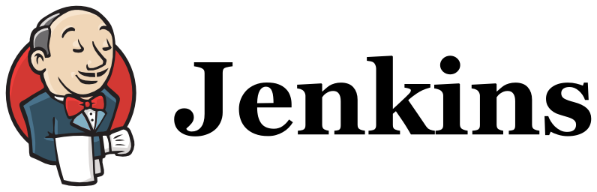

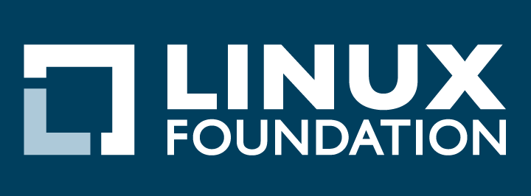

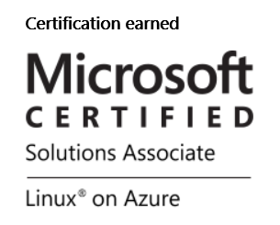
Open Source Investments are Fueling the Momentum
Our Products
Our Offerings
Azure Marketplace
60% of all images in Azure Marketplace are based on Linux/OSS
SQL Server on Linux
Acquisition
Windows Subsystem for Linux
1 out of 3 VMs on Azure run Linux, and more than half of all new VMs run Linux
C:\Users\markhill> bash
1 out of 3
HD Insight managed service on Linux
root@localhost: #
Run Linux on Windows natively
Our Partnerships
Our Employees
Ross Gardler President Apache SW Foundation
Brendan Burns Co-founder of Kubernetes
Partnership
Jenkins project on Azure
Partnership with the Linux Foundation for Linux on Azure certification
600 Million+
Lines of open source code submitted to GitHub by Microsoft engineers
Microsoft joins Eclipse Foundation
Microsoft Open Source Hub
Notes:
Notes soon – please check back on http://aka.ms/opensource for latest version
We are making a bet on OSS by contributing
SQL Server On Linux – In Preview March ‘16
RedHat install in 30 seconds: yum install mssql-server -y
Windows is running Ubuntu user-mode binaries provided by Canonical. Build a subsystem in Windows kernel to expose windows api to Linux user-mode
This means the command-line utilities are the same as those that run within a native Ubuntu environment

Slide 4


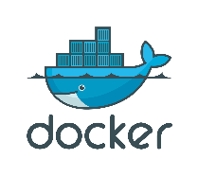



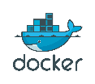







Our approach to open source in the cloud
Our approach to open source in the hybrid cloud
Enable
Integrate
Release
Contribute
An open and flexible platform that meets you where you are and adds value to your existing investments
Embracing leading ecosystems, increase agility and offer consistent open source offerings
Support a strong ecosystem to achieve more through Microsoft’s own portfolio investments
Extend the community and reach to more people, and partner for first-class experiences
R Server
.NET Core
Roslyn
TypeScript
F#
PowerShell
autorest
PowerBI Visuals
Office UI Fabric
MSR projects
Open Source Partners & Ecosystem

Slide 5
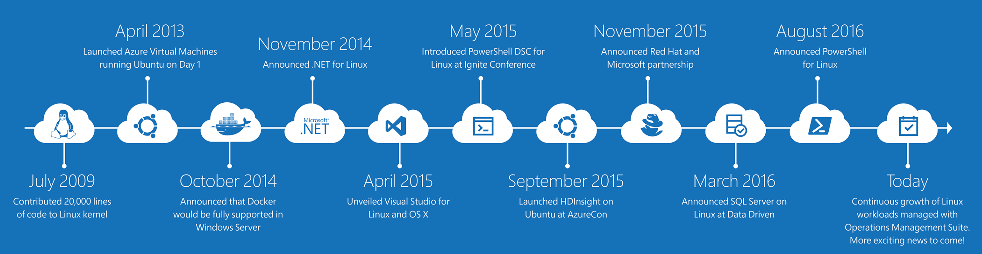
It’s been a journey…
PowerShell is now open source and available on Linux
Linux Agent (GA) & Container Solution (Preview) for Operations Management Suite
Hundreds of contributors to the Azure Resource Manager community on GitHub
…and there’s strong momentum for Linux at Microsoft
4x growth in container customers in Azure since January, all with Docker on Linux!
Nearly 1 in 3 VMs in Azure run Linux today
Over 40% of VMs created in new deployments in Azure today run Linux!

Slide 6
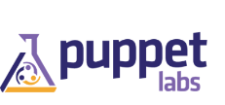


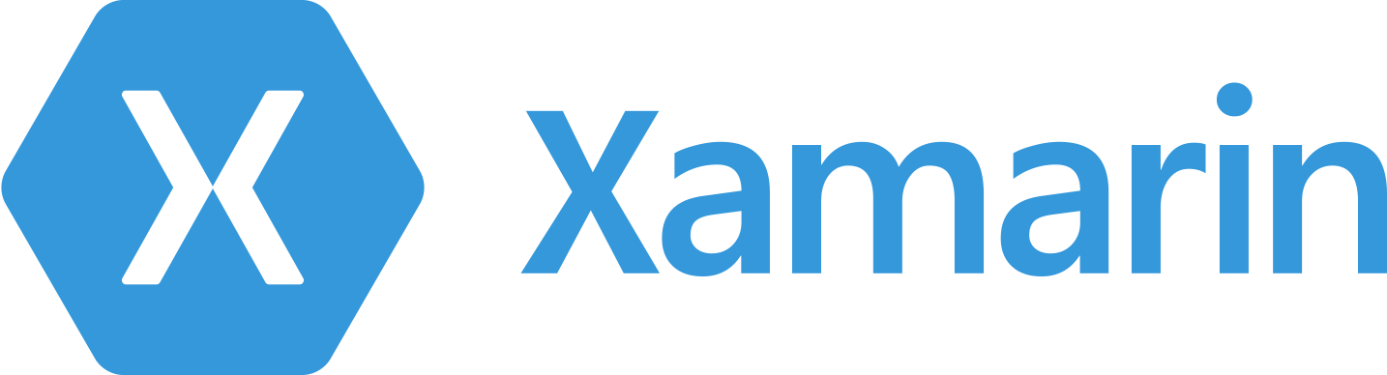









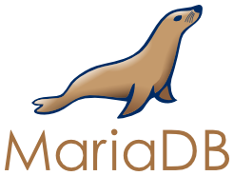

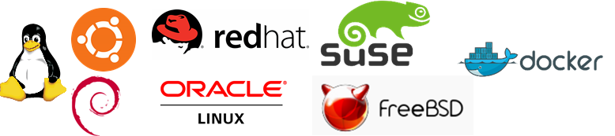


Azure Open Source App Platform
Stakeholders
Developers
Operations
DBAs and data scientists
Business
Office
PowerBI
Virtual Machines
VM Scale Sets
Container Service
Batch
Open Source PaaS
Service Fabric
App Service
Environments
Web, Mobile & API
Logic
Functions
Stateful and stateless one-off solutions
Scalable solutions
Scalable, orchestrated Docker images deployed into containers
Custom High Performance Computing solutions
Custom Microservice-based stateless and stateful solutions
Template based rapid development web, mobile and API solutions
Serverless event driven experience
Cloud Foundry,
OpenShift
All the goodness of App Service in a dedicated environment
Orchestrated workflow based integration solutions
Build on the infrastructure
Build on the platform
Lift-and-shift + net new on Linux
Docker
Cloud-born
LOB
Microsoft Azure

Slide 7










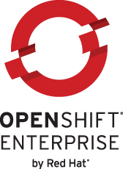







Azure Open Source Container Portfolio
Developer & Data Agility with Containers in the Cloud
Developers
Operations
Data scientists
OMS
Docker VM Extension for Azure
Open source container-based PaaS platforms in Azure
Azure Container Service
Azure Marketplace container partners
Easy and programmatic way to add Docker capabilities to your VMs
Container-ready application platforms that benefit from Azure’s native partitioning, capacity management and high availability
Optimized container hosting in the cloud with familiar tooling and your choice of orchestrator
Partner solutions that address management challenges of containers
Microsoft Azure
Workload portability
Cross-cloud orchestration
Tools integration
Windows Server (preview)
Azure Stack (roadmap)
Your own platform

Slide 8











Azure Open Source Data Platform
Stakeholders
DBAs and data scientists
Operations
Developers
Business
Relational
NoSQL & Cache
Big Data
Relational
NoSQL & Cache
Big Data
Azure SQL Database including revamped client driver support for PHP, Node.js, Java, Linux ODBC and more
Azure DocumentDB, including native MongoDB wire protocol support, and Redis Cache
Functions
Azure HDInsight – full Hadoop solution available as a service on Windows and Linux
Collective set of multiple data sets organized by tables, records and columns
Non-relational DBs where data is modelled in means other than the tabular relations used in relational databases
Accept data at a very high velocity, and store structured and unstructured data in an efficient and scalable way across nodes
Leverage cloud infrastructure
Build rapidly and connect to the platform
Dev/Test, Production and Lift & Shift
Docker, incl. via DC/OS
Cloud-born
LOB
Microsoft Azure

Slide 9


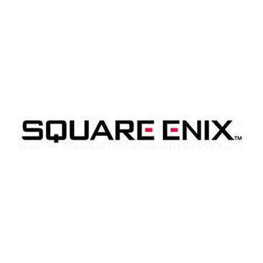


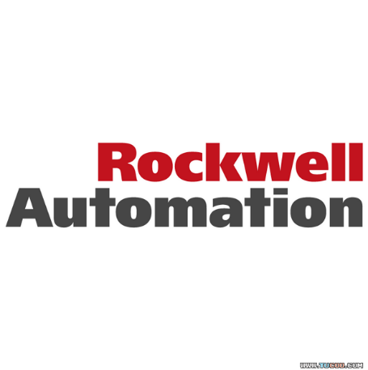





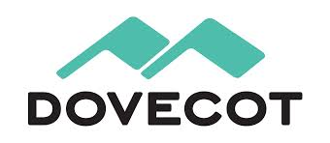



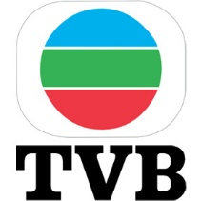


















Open Source on Azure Customers More customer stories at customers.microsoft.com!
Notes:
Timing: 1 minute
Talking points:
Go to customers.microsoft.com for many more customer stories highlight support for open source software on Microsoft Azure.
http://www.microsoft.com/casestudies/Case_Study_Detail.aspx?CaseStudyID=710000004217
http://www.microsoft.com/casestudies/Case_Study_Detail.aspx?CaseStudyID=710000003432
http://www.microsoft.com/casestudies/Case_Study_Detail.aspx?CaseStudyID=710000004447
http://www.microsoft.com/casestudies/Microsoft-Azure/The-British-Irish-Lions/Top-Global-Rugby-Team-Wins-with-Cloud-Apps-That-Motivate-Fans-Monitor-Player-Health/710000003811
http://www.microsoft.com/casestudies/Windows-Azure/Cognosys-Technologies/Cognosys-Facilitiates-Azure-Transitions-in-Minutes-Exponentially-Reduces-Go-To-Market-Time/710000002544
http://www.microsoft.com/india/casestudies/microsoft-azure/cloudmunch/solutions-firm-uses-the-cloud-to-speed-release-cycles-and-cut-it-costs-by-more-than-20-percent/710000004304
https://customers.microsoft.com/Pages/CustomerStory.aspx?recid=338
http://www.microsoft.com/casestudies/Case_Study_Detail.aspx?CaseStudyID=710000004458
https://customers.microsoft.com/Pages/CustomerStory.aspx?recid=1867
http://www.microsoft.com/casestudies/Windows-Azure/Semantic-Touch/Azure-Powers-Launch-of-Revolutionary-Open-Source-Social-E-commerce-Solution/710000001825
http://www.microsoft.com/casestudies/Case_Study_Detail.aspx?CaseStudyID=710000003201
http://www.microsoft.com/casestudies/Windows-Azure/Nanobi-Data-and-Analytics/App-Store-in-the-Cloud-Democratizes-Analytics-Adoption-Across-Businesses/710000002921
http://www.microsoft.com/casestudies/Case_Study_Detail.aspx?CaseStudyID=710000002158
http://www.microsoft.com/casestudies/Windows-Azure/Vibal-Publishing/Leading-publishing-house-combines-open-source-technology-with-Microsoft-Windows-Azure-for-more-efficient-delivery-of-digital-learning-tools/710000003099
http://www.microsoft.com/casestudies/Case_Study_Detail.aspx?CaseStudyID=710000001977
http://www.microsoft.com/casestudies/Windows-Azure/Virginia-Polytechnic-Institute-and-State-University/University-Enables-Innovative-Life-Sciences-Research-with-Big-Data-Solution/710000003381
http://www.microsoft.com/casestudies/Case_Study_Detail.aspx?CaseStudyID=710000003415

Slide 10












Azure is Open Up & Down the Stack
Heterogeneity
Open, Broad
and Flexible
Enterprise needs
Integration
Languages
Heterogeneity
CMS
Devices
Microsoft Azure fundamentals
On-premises AND Cloud
Databases
Open, Broad
and Flexible
Operating systems
Notes:
Timing: 2 minutes
Script:
Open, Broad and flexible: We realize that you’ll want to run a variety of workloads in the cloud. In Microsoft Azure, we will of course provide first and best experience and support for Microsoft workloads, but at the same time we have embraced other open technologies so you get a cloud experience that satisfies your heterogeneous needs.
In enterprises, Java and .NET are still most used, but developers are also using PHP, Python and other languages in addition. Microsoft Azure supports all these languages and more.
Microsoft Azure provides out-of-the box experience for open frameworks like Hadoop, web frameworks like Wordpress, Joomla and Drupal. We also provide first party SDKs for developing apps using Android, IOS or Windows phones.
We not only support, but have embraced open technologies.
We also provide a broad set of services that provide you a good choice. In addition to the breadth of the platform, it’s important to note that using Microsoft Azure is not an all or nothing proposition. You can use most services independently of each other. For example, you can just use storage without compute or use DB without using storage. What you want to use and how you want to use is really YOUR choice.
OLD NOTES FOR MERGING:
Timing: 3 minutes
Key Points:
Microsoft Azure is an open and flexible cloud platform.
Developers can build applications using any language, tool or framework – including open source languages such as PHP, Java, and Node.js, and other open source tools.
Support for Linux images (CentOS, openSUSE, SUSE, and Ubuntu) on Microsoft Azure Virtual Machines as part of the Infrastructure Services offering.
Support for multiple frameworks and popular open source applications through Microsoft Azure Web Sites.
Script:
As part of our cloud platform, interoperability is a design-time requirement. Microsoft Azure is an open and flexible cloud platform that enables customers to quickly build, deploy and manage applications across a global network of Microsoft-managed datacenters. To do it right we know we’ve got to be open.
Developers can build applications using any language, tool or framework – including open source languages such as PHP, Java, and Node.js, and other open source tools – which means they can utilize familiar open source skills on Microsoft's cloud platform. Currently features and services in Microsoft Azure are exposed using open REST protocols. Microsoft Azure client libraries are available for multiple programming languages and are released under an open source license and hosted on GitHub.
As Microsoft continues to provide incremental improvements to Microsoft Azure, we remain committed to working with customers to support their mixed IT environments. Other recent interoperability enhancements include: Eclipse Plugin for Java, Mongo DB support, code configuration for hosting Solr/Lucene, and the Hadoop services preview Microsoft Azure HDInsight.
Our Infrastructure Services offering includes support for Linux images (CentOS, openSUSE, SUSE, and Ubuntu) on Microsoft Azure Virtual Machines. And, further support for multiple frameworks and popular open source applications through Microsoft Azure Web Sites (note: see appendix slides for more detail on Virtual Machines and Web Sites).

Slide 11
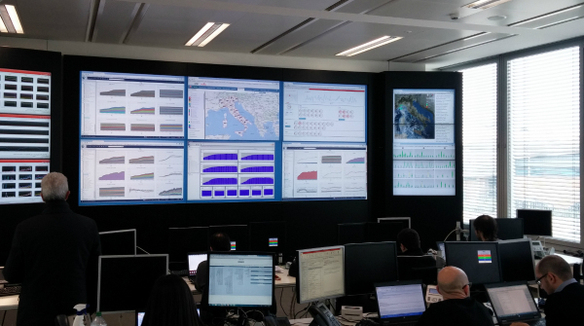









Open Source on Azure: Industry Trends
DevOps
Hosted Services
Next-Gen Architectures
Internet of Things
OS management tools
SDKs and multiple languages
Dev/ Test Environments
Migrate Existing Apps
Commercial and Community Distributions, Strong Partner ecosystem
Extend to Cloud
Lift & Shift VMs
Big Data Analytics
Hyper-scale software- defined storage, Containers & micro service architectures
Dev/ Test
Rapid App Development
Powerful backend for all devices, RESTful interfaces, AMQP support
Devices & Streaming
Connected Sensors
Notes:
Key Points:
how we are collaborating and forming strategic partnerships with open source communities to support key industry trends so we can EMPOWER you.
The main industry trends covered are – DevOps | Hosted (Managed) services | Next-Gen Architectures – like Containers | IoT
Talking Points:
Our collaboration and strategic partnerships with open source communities is to enable key industry trends with Azure. How do we empower you, by supporting your existing infrastructure while you extend/ transition and take advantage of the economics/ scale of cloud. When you look to the cloud, the top industry trends that drive your needs are:
DevOps: Many customers are looking at DevOps as a way to accelerate application delivery lifecycles. Your software applications will likely include both Linux- and Windows-based components. With our Microsoft Azure cloud platform you can also use a host of popular open source DevOps tools such as Puppet, Chef, Ansible, SALT to build DevOps environments for your company from a zero-process environment to a fully automated and deployed production environment.
Hosted (Managed) Services: Microsoft provides great options for customers looking for Managed Services solutions and tools. With Azure Managed Services, customers can outsource service management, including architecture, deployment, and updates, to Microsoft. You have flexibility in your Migration/ extension/ Lift & Shift – you can build your own image (VM), Start from a VM in Marketplace, Start from a community image in VMDepot, Add through VM Extensions or deploy advanced solution frameworks.
Next generation architectures, When it comes to application development/ deployment - containers are emerging as an attractive way for developers to quickly and efficiently build and deploy these “born in the cloud” applications. We are also integrating the Docker Hub into the Azure Marketplace so customers will have a seamless access to the latest Docker technology.
Internet of Things. Businesses are connecting their “things” (devices or sensors) to drive data insights and create new value and improve services. The Microsoft Azure IoT Suite is an integrated offering that takes advantage of all the relevant Azure capabilities to drive operational performance, use advanced data analytics, and enable innovation.
Bottom line – we’re investing in technology and partnerships to EMPOWER you to take advantage of these key industry trends.

Slide 12
Open Source on Azure: Business Scenarios
Category | Technology | Description of Services | Business Scenarios | Benefits
DevOps | Open Platform | Choose any language/ framework like Java, Node.js, PHP, Python, Ruby | Dev Test Environments Migrate Existing Apps | Leverage existing talent and investments
 | Management Tools | Manage VMs with open-source DevOps tools like Puppet, Chef, Kubernetes etc., | Dev Test Environments Lift and Shift VMs | Reduce OPEX, enable hybrid environments
Hosted Services | Licensed Distributions | Azure-endorsed distributions like Canonical, CoreOS, Open Logic, Oracle, SUSE, Red Hat | Extend to the Cloud Lift and Shift VMs | Agility, Reduce CAPEX & OPEX,
 | Community built Distributions | VMDepot offers 1000s of community provided Linux Images | Extend to the Cloud Lift and Shift VMs | Agility, Reduce CAPEX & OPEX
 | Enterprise Workloads | SAP, Oracle, SQL and non–SQL data stacks such as Cloudera Enterprise, Datastax, and Mongo DB | Enterprise Web and LOB Apps Hybrid environments | Reduce CAPEX & OPEX, Achieve Enterprise SLAs
 | Big Data Analytics | Fully managed Hadoop distributions like Cloudera, Horton Works, HDInsight | Mobile & Social Apps Gaming High Scale Apps IoT | Full Managed, No CAPEX, Hyper-scale
Next Generation Architectures | Containers | Deploy a full Docker host in minutes from Marketplace or CLI | Dev Test Application developments | Fast & Agile, Rich Collaboration
Internet of Things | IoT Suite | Fully managed services like (IoT Hub, Cortana Analytics) for device and sensor data | Real-Time analysis, Predictive Analytics, Streaming and Device sensor data | Fully managed, Fast and Agile, New Business models
Notes:
Key Points:
These scenarios are a good starting point to introduce our customers to OSS on Azure capability.
Talking Points:
I would like to briefly talk about how we are collaborating and forming strategic partnerships with open source communities to support key industry trends so we can EMPOWER you.
DevOps: Many customers are looking at DevOps as a way to accelerate application delivery lifecycles. Whether you’re a developer working in a start-up or an IT professional in a growing enterprise, your software applications will likely include both Linux- and Windows-based components.
With our Microsoft Azure cloud platform you can also use a host of popular open source DevOps tools such as Puppet, Chef, Ansible, SALT to build DevOps environments for your company from a zero-process environment to a fully automated and deployed production environment. (Read more here: https://www.microsoft.com/en-us/Openness/DevOps)
Use your favorite language: Language-specific SDKs and tools make it quick and easy to develop, test, and deploy your apps in the cloud. Azure supports languages including Java, Node.js, PHP, and Ruby. The Azure Documentation Center has language-specific how-to information, sample code, and community forums. Azure SDKs are all open source and hosted on GitHub.
2. Hosted Services: Microsoft provides great options for customers looking for extending their existing environments to the cloud, or Managed Services solutions and tools.
Whether you are looking for Lift and Shift Linux VMs or extending a Linux deployment to the cloud for burst capabilities – you have a choice of more than 1000 community build Linux OS’es and Azure endorsed commercial distributions. You can deploy these in minutes.
From the marketplace you have deploy VMs for Enterprise solutions like SAP Hana, Oracle, Cloudera, Datastax or Mongo DB (or) deploy them as fully managed services inside Azure.
For Big Data Analytics, Azure supports a wide range of fully managed Hadoop frameworks – Cloudera Enterprise, The Horton Works Distribution Platform and Microsoft’s native Hadoop distribution – HDInsight, a fully managed service that runs on both Windows & Linux.
3. Next Generation Architectures:
When it comes to Next generation architectures, containers are emerging as an attractive way for developers to quickly and efficiently build and deploy these “born in the cloud” applications. We offer containers with a new level of isolation previously reserved only for fully dedicated physical or virtual machines, while maintaining an agile and efficient experience with full Docker cross-platform integration. We are also integrating the Docker Hub into the Azure Marketplace so customers will have a seamless access to the latest Docker technology. (Read more about this here: https://www.microsoft.com/en-us/Openness/NextGenerationCloud)
4. IoT: And lastly, the Internet of Things. Across the globe, businesses and governments are connecting their “things” (devices or sensors) to drive data insights and create new value and improve services. The Microsoft Azure IoT Suite is an integrated offering that takes advantage of all the relevant Azure capabilities to drive operational performance, use advanced data analytics, and enable innovation. Available in preview later this year this new offering will provide enterprises with finished applications targeting common IoT scenarios – such as remote monitoring, asset management and predictive maintenance – to simplify deployment and provide the ability to scale their solution to millions of “things” over time. (Read more here: https://www.microsoft.com/en-us/Openness/InternetOfThings)
Overall - We have the technology & support for your business scenarios.

Slide 13


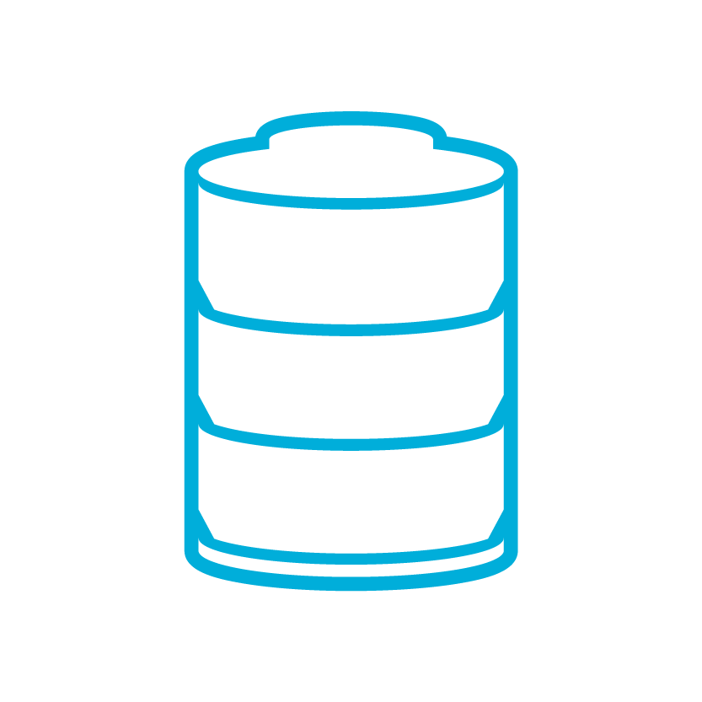

Deploying in a Traditional Data Center
Setup Network Infrastructure
LB
WEB
APP
SQL
Setup Server Infrastructure
Install and Patch OS
Install and Configure Apps
80
Multiple Environments?
Rinse and Repeat
Networking Infrastructure

Slide 14
Deploying IaaS in Microsoft Azure
Configure Network Settings
LB
WEB
APP
SQL
Create Virtual Machines w/OS
Patch OS
Install and Configure Apps
80
Multiple Environments?
Rinse and Repeat
Virtual Network

Slide 15



web apps
shared
standard
1
shared
Shared instances
:-)

Slide 16
web apps
shared
standard
2
shared
Shared instances
:-)
:-)

Slide 17

web apps
shared
standard
0
1
standard
Shared instances
Standard instance
:-)
:-)
:-)

Slide 18
web apps
shared
standard
2
standard
Standard instance
Standard instance
:-)
:-)

Slide 19
Web apps auto-scaling
standard
cpu utilization
Standard instance
Standard instance
Standard instance
:-)
:-)
:-)

Slide 20
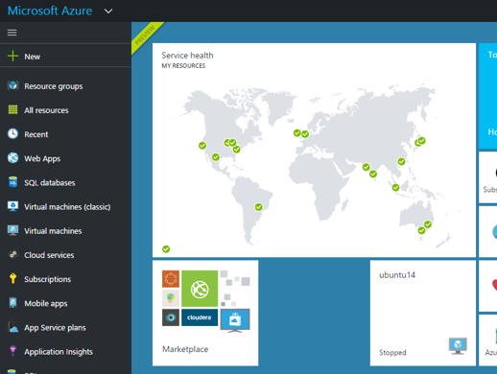
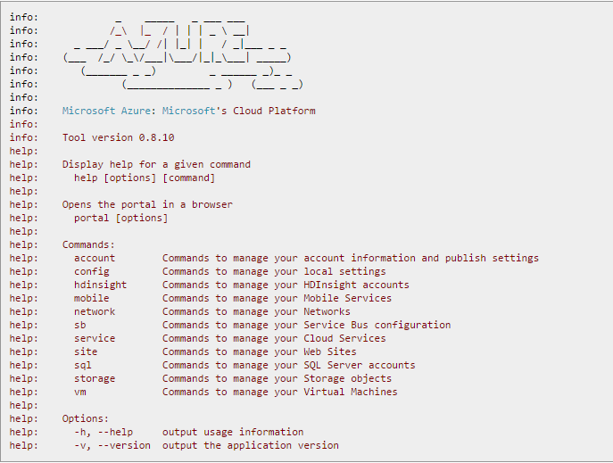
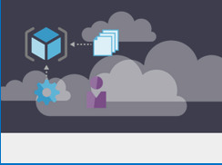
Provisioning
Azure Portal
Azure CLI
ARM Templates
Notes:
Speaker Pointers:
1. This slide highlights the multiple ways to provision VMs

Slide 21
Q & A

